Slide 1
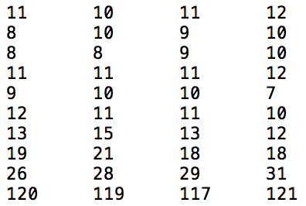
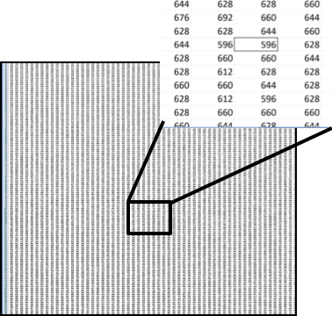
Pixels / Voxels
Image = { value, coordinate }
y
x

Slide 2
Image coordinates and values
X
Y

Slide 3
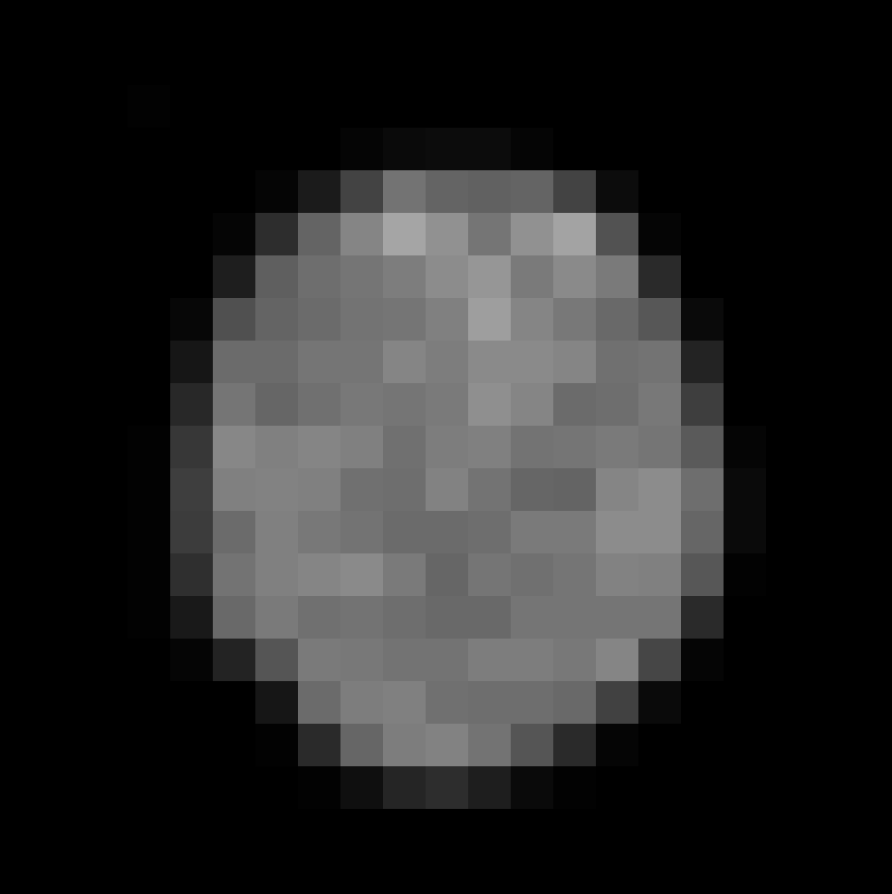
image_data/xy_8bit__nucleus_calibrated_downscaled.tif
figures/resources/pixels.xls

